Slide 1
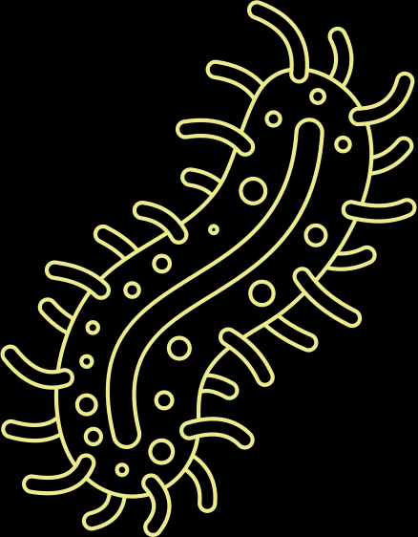
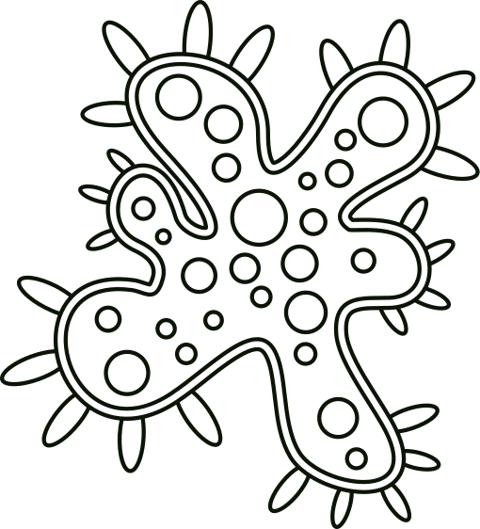
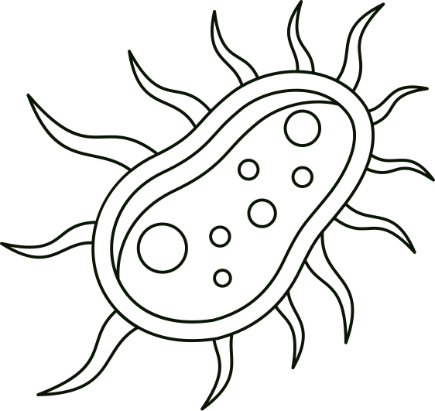
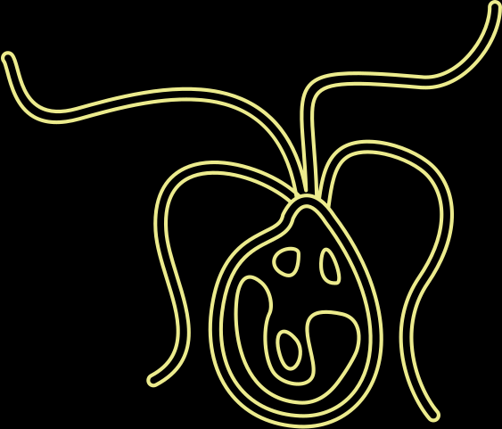
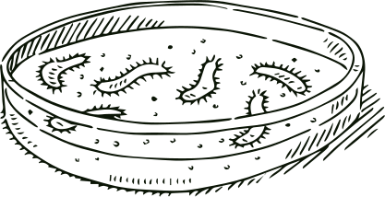
ANA PEREZ
MICROBIOME REPORT

Slide 2
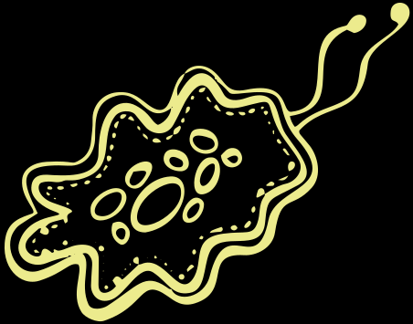
INTRODUCTION
Interested in Oral Health
Analysis of oral microbiome of completely edentulus diabetic patients
Notes:
-Interested in dentistry; something to talk about when getting an interview
-The research itself was conducted in India, and they wanted to see the microbiome of patients with no teeth in diabetic patients

Slide 3
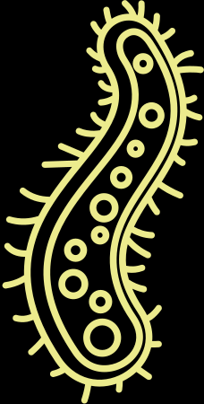
1
Human oral microbiome pre and post treament for 4 different patients
METHODS
Used Qiime2 artifact, Moving Picture Tutorial
2
3
Analyzed microbiome through visualizations on taxonomy, alpha divesity and beta diveristy based on subjects such as patient and pre or post treament
Notes:
Saliva sample was collected a year ago in May from 4 different patients, and this was done pre and post treatment. Treatment was not specified when doing my research. I used Qiime through my terminal to be able to analyze and interpret the microbiome in the oral health of the patients, by using the data that was sequence through ILLUMINA. Important to mention that these sequences were paired-end sequences. Qiime helped me demultiplex the data by separating it and sorting it accordingly. Qiime was able to remove any low quality regions from the dat so my results could come out clear and easy to interpret. It also created visualizations where i was able to analyze the taxonomy found in the patients as well as the alpha and beta diversity of the microbiome.

Slide 4
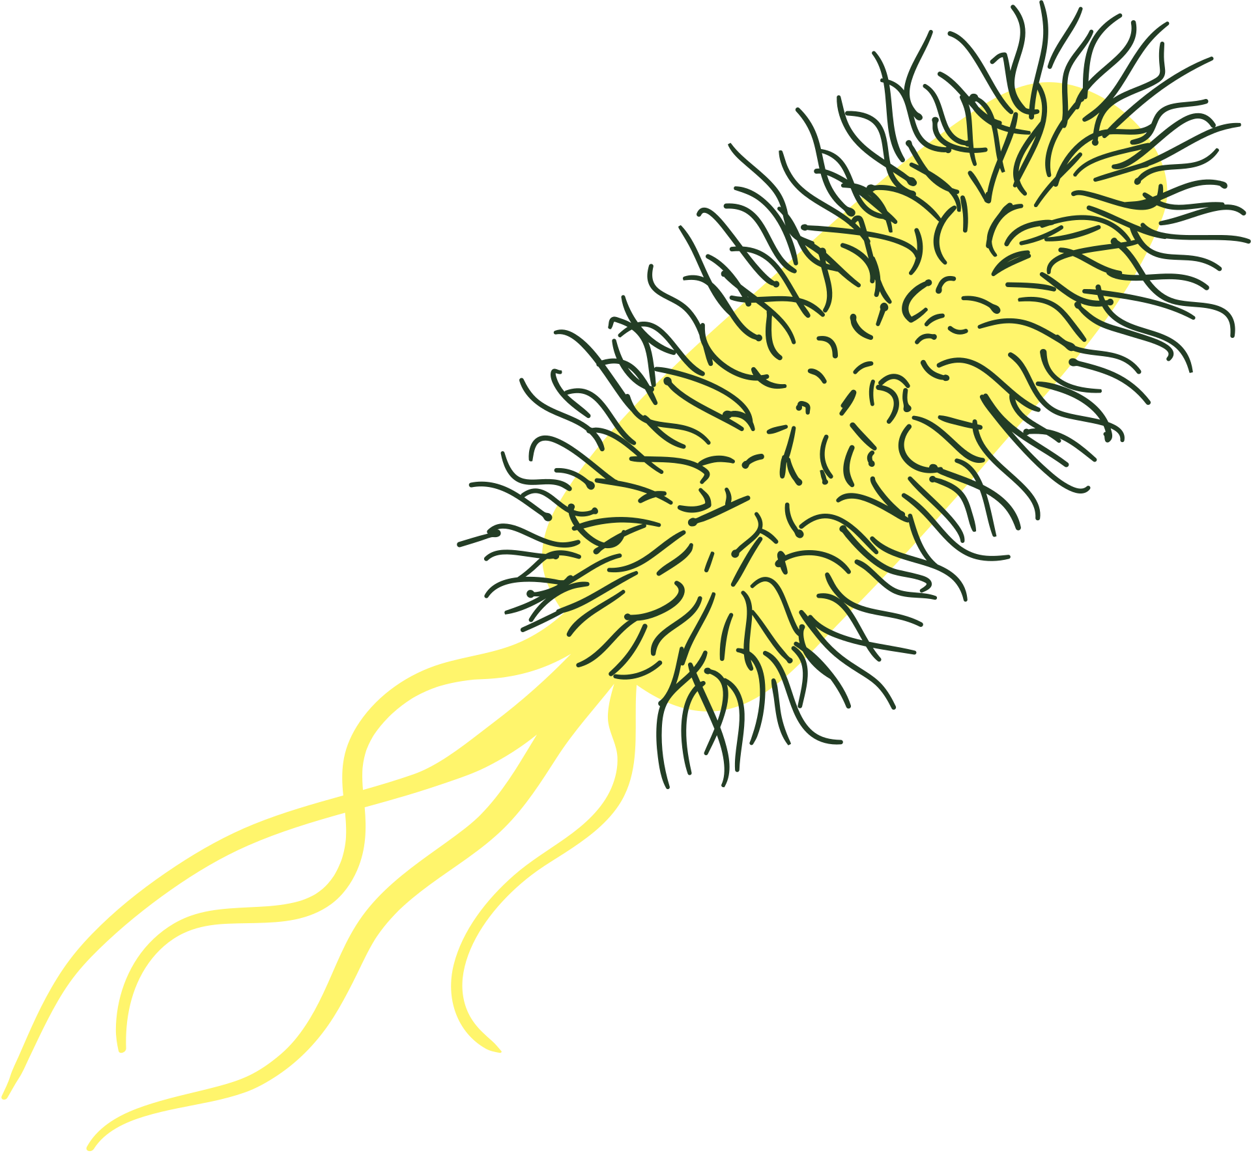

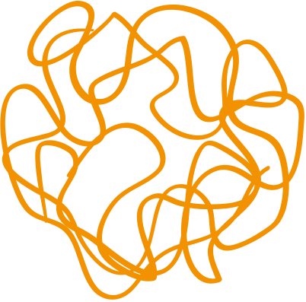

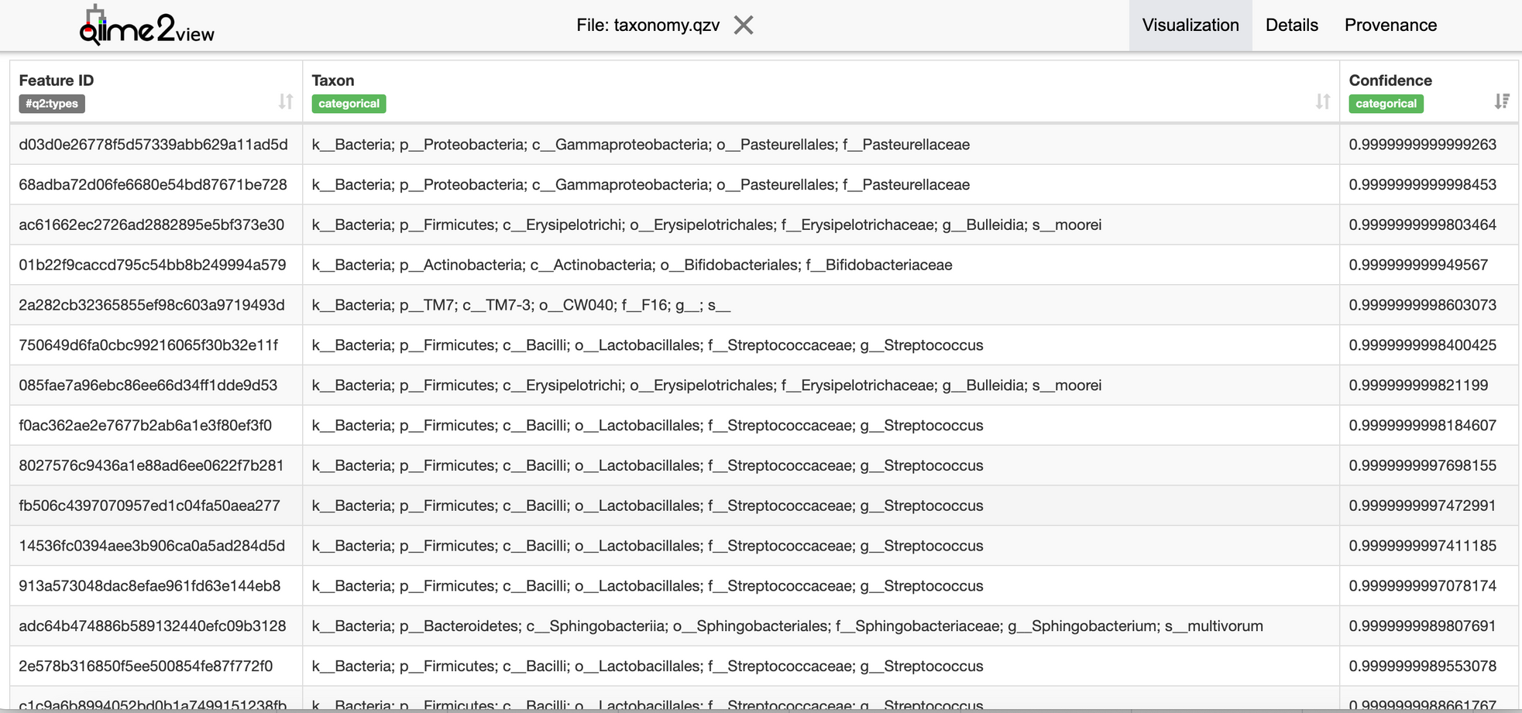
RESULTS: TAXONOMY
Notes:
Top hits sorted by confidence
Strep, Pasteurellaceae, Actinobacteria

Slide 5
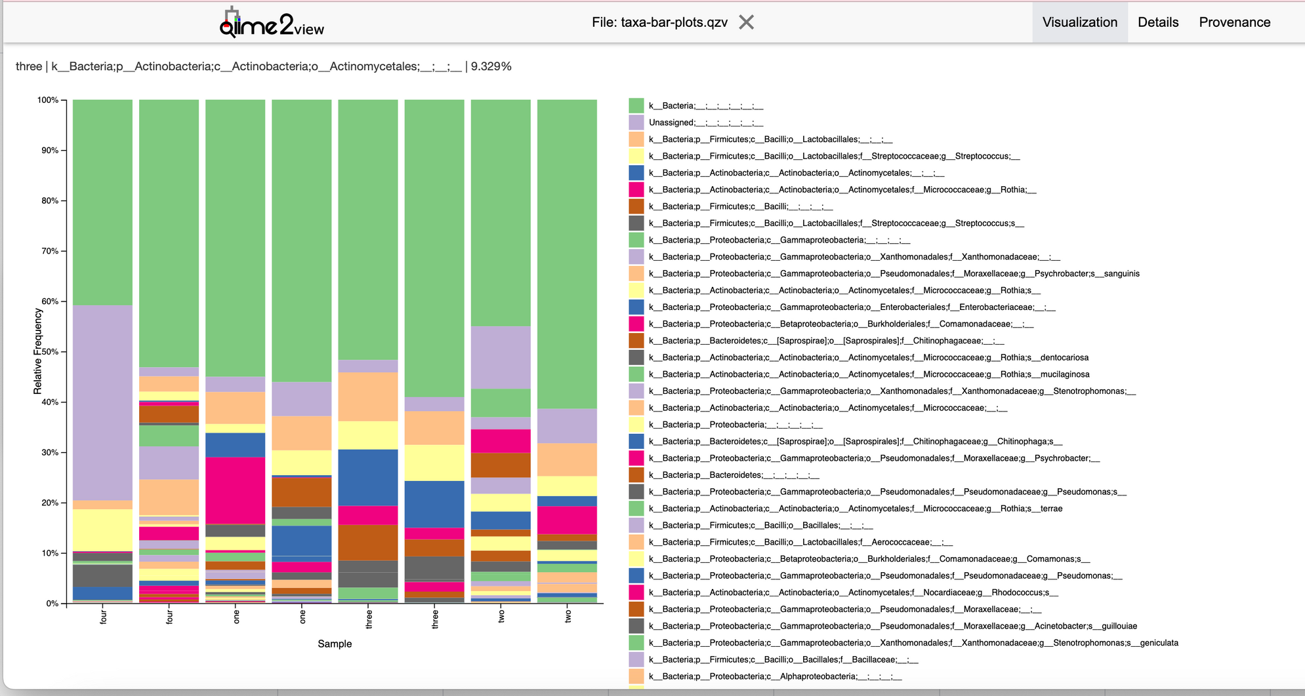
RESULTS: TAXONOMY
Notes:
Species level, patient (pre and post)

Slide 6
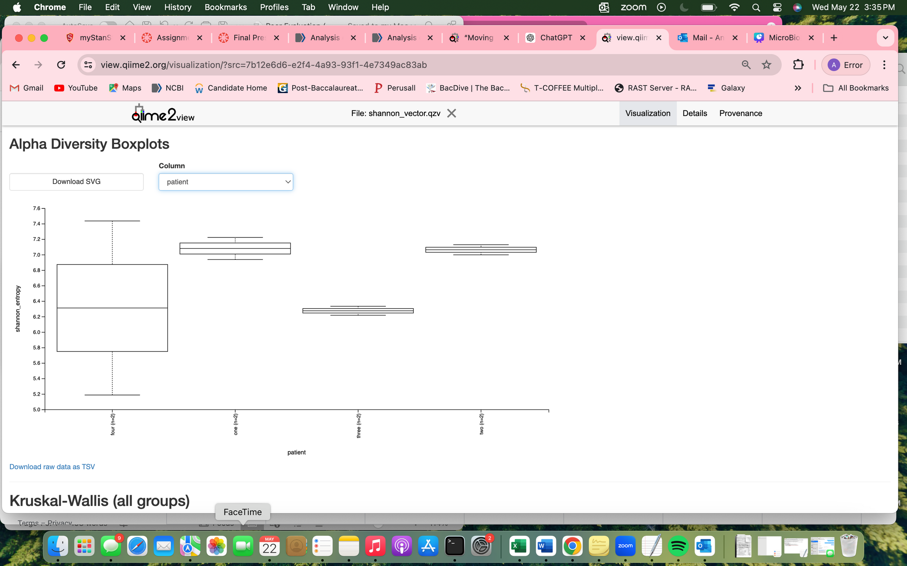
RESULTS: ALPHA DIVERSITY
p-value: 0.57

Slide 7
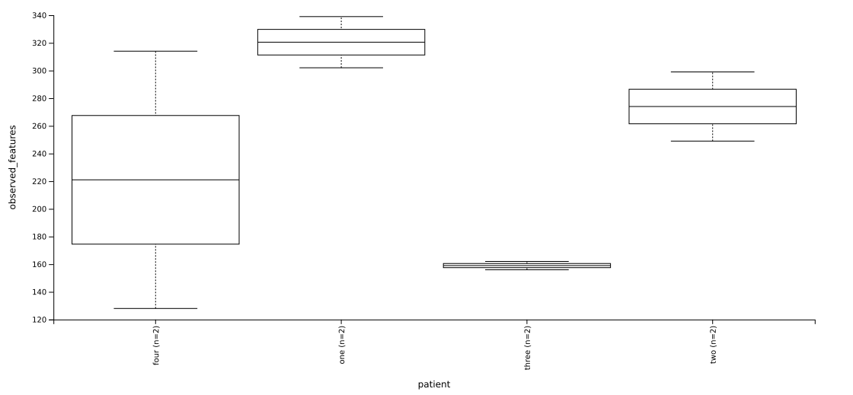
RESULTS: ALPHA DIVERSITY
p-value: 0.32
Notes:
difference between shannnon and observed features

Slide 8
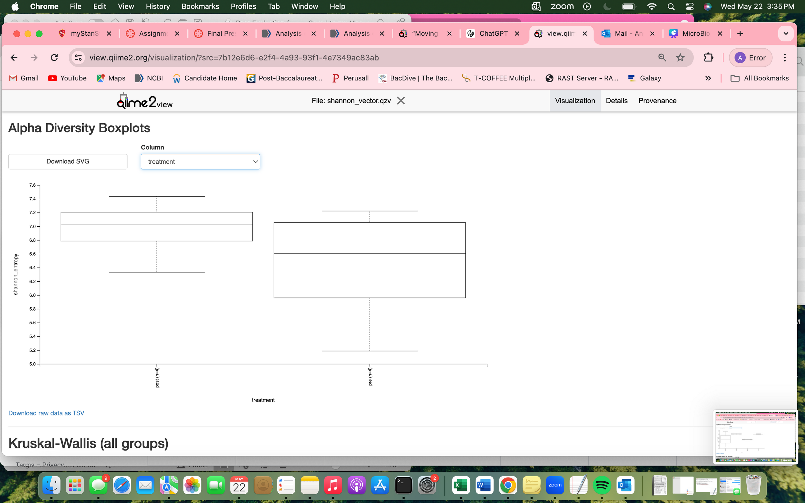
RESULTS: ALPHA DIVERSITY
p-value: 0.38

Slide 9
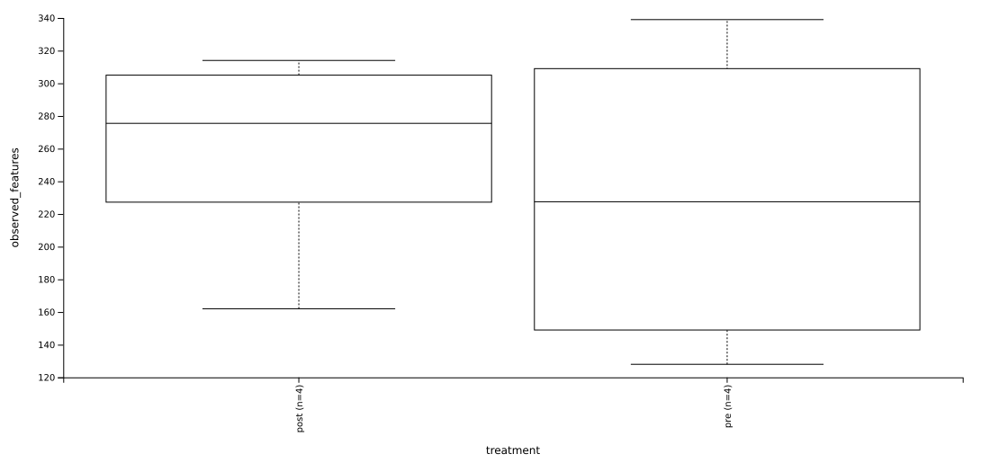
RESULTS: ALPHA DIVERSITY
p-value: 0.56

Slide 10
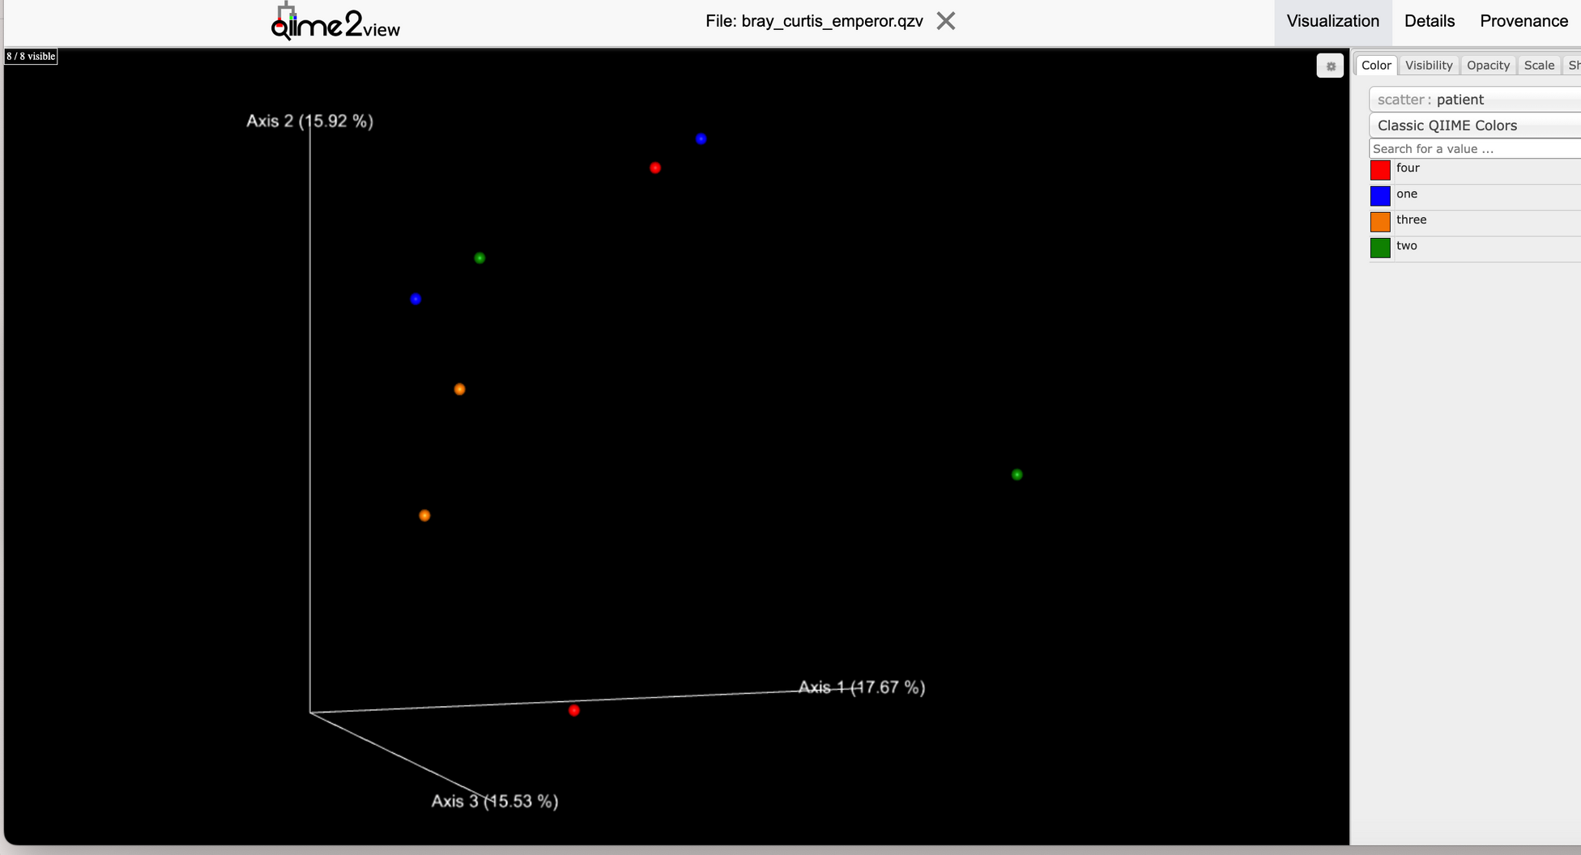
RESULTS: BETA DIVERSITY
Axis 1: 17.67%
Axis 2: 15.92%
Axis 3: 15.53%
Notes:
The percentage next to each axis label shows how much of the total variation is explained by that axis.
Sample Positioning: Samples closer together on the plot are more similar, while those further apart are more dissimilar.

Slide 11


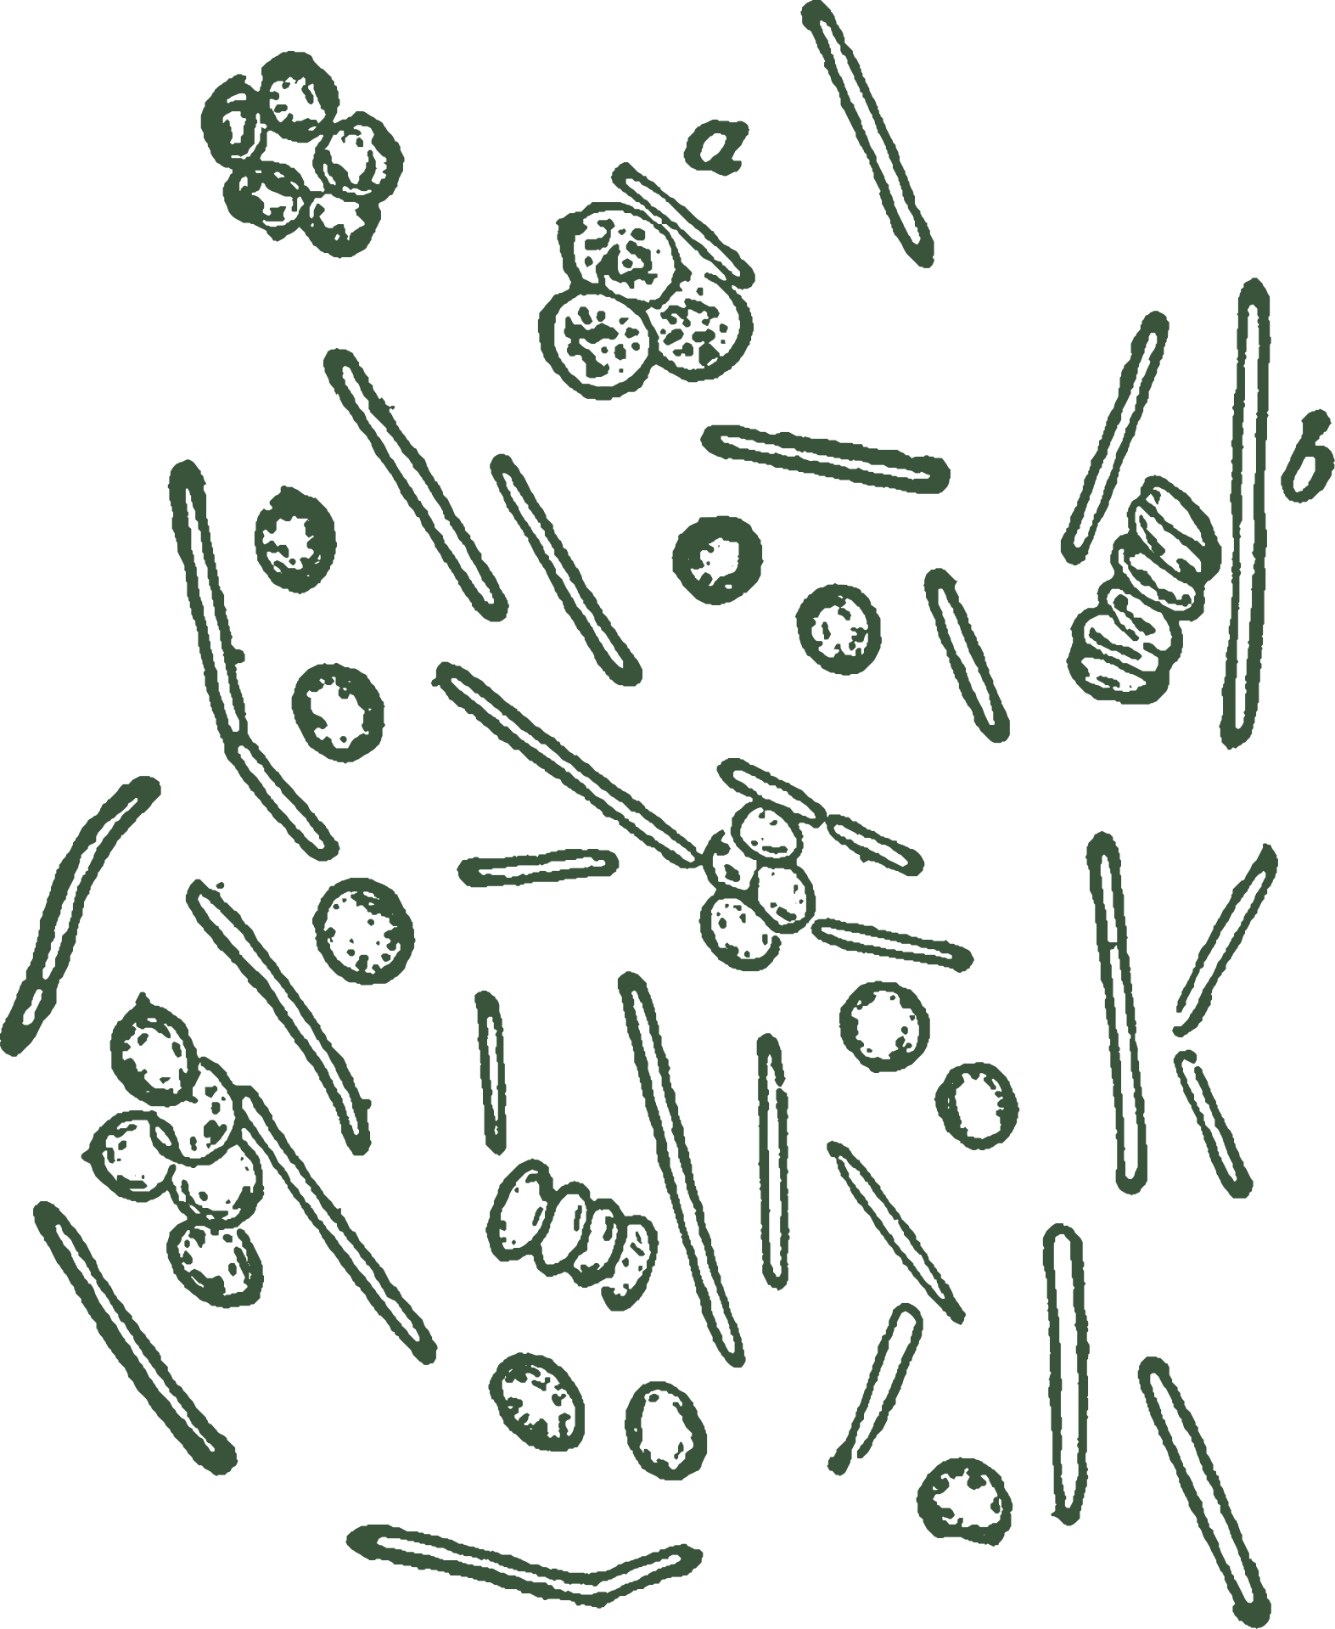
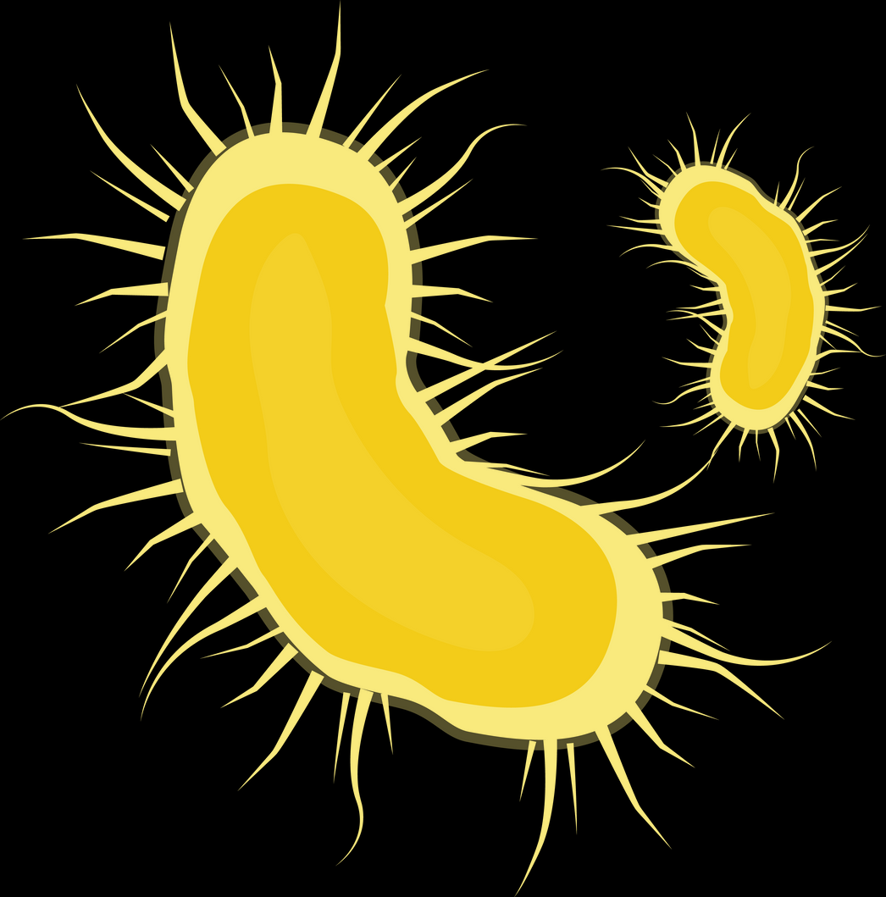
THANK YOU

